Slide 1

Marijuana
(Cannabis/THC):
Information for Teens
Notes:
Marijuana (Cannabis/THC): Information for Teens was created by the
Chippewa Valley Coalition for Youth and Families, a school-community coalition in
mid-Macomb County, Michigan. It provides research-based information from
national sources, including the Centers for Disease Control and Prevention (CDC) and others.
Please note that the term "marijuana" is used throughout the lesson because it is the term used in the
Michigan Model for Health. The terms "cannabis/THC" are also used for increased clarity.
This lesson takes approximately 2 hours to present, with activities and discussion.
The lesson has been reviewed by Sara Orris, Health Consultant at Macomb ISD and can be used to complement the
Michigan Model for Health. National Health Education Standards were considered during the creation of this
lesson and can be found at: https://www.shapeamerica.org/MemberPortal/standards/health/default.aspx
A Message to Teachers and Others Using Marijuana (Cannabis/THC): Information for Teens
Many children and adolescents today have significant misperceptions about marijuana.
National drug survey data, Monitoring the Future 2024, shows a positive trend across
the grade levels, including high school, in the perception that marijuana use can be harmful.
The intention of this PowerPoint lesson, with video, is to provide accurate, research-based
information to educate youth about the real dangers of marijuana use, especially during adolescence.
This lesson is intended to be used as an instructional unit for students in high school health
or other classes and/or for educational presentations to youth groups in other settings,
e.g., churches, recreational centers, etc.
When some adolescents are provided with information about the dangers of marijuana use,
they may respond with adamant disbelief, given their lack of fact-based information
and the likelihood that some are marijuana users. In piloting this unit, we discovered that expressions
of disbelief can lead to stimulating and helpful discussions.
We have also found it constructive to take the following positions, in presenting this information:
I am not trying to convince you of anything. I am providing you with research-based information to consider.
You might do some research yourself to see what you discover, however, there is much misinformation
about marijuana on the internet. I can give you some reliable and research-based resources to review.
Be careful to separate opinion from research-based facts.
Information to assist in using Marijuana (Cannabis/THC): Information for Teens:
Many of the slides have accompanying information.
These include Teacher Notes that provide supplemental information for teachers.
Other slides may have Teacher Comments, statements found useful during the piloting of the curriculum
to enhance student learning. Some Teacher Comments are purposefully informal to be “student friendly”.
In addition, some slides provide suggested Group Activities to promote discussion.
Supplemental materials-Cannabis: The Facts You Need to Know, created by the National Institute on Drug Abuse-are available for this lesson:
https://nida.nih.gov/sites/default/files/NIDA_YR20_INS1_StudentMagazine.pdf
2. https://nida.nih.gov/research-topics/parents-educators/lesson-plans/cannabis-the-facts-you-need-to-know
This presentation was updated during August 2025.

Slide 2
What is Marijuana?
Also called cannabis, THC, dabbing, shatter, sparking up, weed, pot, 420
A mixture of the dried and shredded leaves, stems, seeds, and flowers of the cannabis plant
Has a chemical in it called
delta-9-tetrahydrocannabinol (THC),
the main addictive ingredient
Centers for Disease Control and Prevention (CDC)
Notes:
A Reminder – some of the following slides have
TEACHER COMMENTS, statements that may be used in class to enhance the lesson, and/or
TEACHER NOTES, supplemental information for teachers
Teacher Notes:
What is marijuana?
Marijuana refers to the dried leaves, flowers, stems, and seeds from the Cannabis sativa or Cannabis indica plant.
The plant contains the mind-altering chemical THC and other similar compounds.
Extracts can also be made from the cannabis plant.
Marijuana is often vaped and sometimes mixed into foods, “edible marijuana”, or drinks.
https://www.cdc.gov/cannabis/about/index.html

Slide 3

Group Activity
Estimate the percentage of 12th graders in an anonymous national survey that reported never using marijuana.
Notes:
Group Activity (Preparing students for next slide):
Estimate the percentage of 12th graders in an anonymous national survey that reported never using marijuana.
Write the estimated percentages on the board.
(The next slide provides the answer.)
The survey is the Monitoring the Future Survey conducted by the University of Michigan each year.

Slide 4
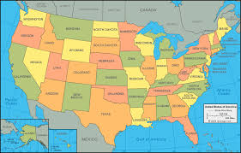
National Monitoring the Future Survey (2024)
University of Michigan
12th Graders
Over 75% had NEVER USED Marijuana
Notes:
Teacher Comments:
Many people your age overestimate the number of teens that use marijuana.
Over 75% of 12th grade students that took an anonymous national survey said they HAD NEVER used marijuana.
How does this compare to your guess?
MOST TEENS DO NOT USE MARIJUANA.
Teacher Notes:
The Monitoring the Future Survey is funded by the National Institute on Drug Abuse (NIDA),
part of the National Institutes of Health (NIH). The survey is conducted by the University of Michigan.
To view full survey data, visit https://monitoringthefuture.org/wp-content/uploads/2024/12/mtf2025.pdf

Slide 5

Group Activity
Why Do Some Teens Use Marijuana (Cannabis/THC)?
Notes:
Group Activity (Preparing students for next slide):
Ask students more specifically “Why do you think some teens try marijuana after they have been given
information about how risky marijuana use is?”
Brainstorm and write their answers on the board.
Discuss their answers.
(The next slide provides the answers.)

Slide 6
Why Do Some Teens Use Marijuana (Cannabis/THC)?
Pressure from friends
Boredom
Influence of media
Insecurity/To “fit in”
To rebel
To deal with uncomfortable feelings
Curiosity Misinformation (Believe it’s safe)
Partnership to End Addiction
Notes:
This slide contains animations.
Each mouse click will advance to the next item on the slide.
Discuss some of their answers.
Resume showing the complete slide (STOP at “Believe it’s safe”) .
Note and discuss any reason why teens use marijuana that hasn’t been mentioned.
https://drugfree.org/article/why-teens-drink-and-experiment-with-drugs/ April 2024

Slide 7
Important lessons can be learned from the history of tobacco.
For a long time, people believed smoking cigarettes was safe.
Many years ago, tobacco was used as a medicine for some illnesses.
Research began to link cancer to burned tobacco.
Tobacco companies tried to hide the dangers from the public.
Tobacco use caused millions of deaths before the public were made aware.
In 1998, the tobacco industry was fined $206 billion for the damage.
It took decades for the public to learn
about the dangers of tobacco.
How long will it take to understand
the dangers of marijuana?
Scholastic Magazine
Notes:
Teacher Notes:
Read the slide and encourage discussion.

Slide 8
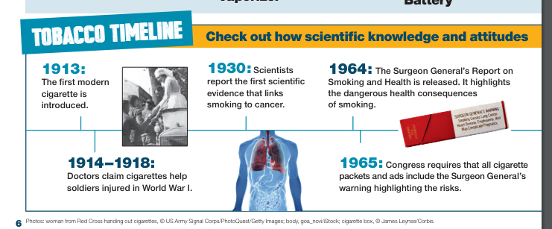
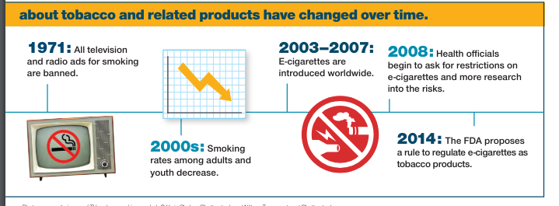
Timeline for Tobacco
Scholastic Magazine
Notes:
Teacher Comments:
Did you know that between 1914 – 1918 doctors mistakenly thought that tobacco could be used as medicine (see diagram)?
Did you know that from 1920 – 1950 many people smoked cigarettes and thought it was safe to do so?
People smoked openly in restaurants and public places. Most had ashtrays in their homes.
Movies, cartoons, and advertisements often showed people smoking.
Group Activity:
Raise your hand if you believe that smoking tobacco cigarettes is dangerous. (Note that almost all or all hands are raised.)
What do you think happened to change people’s minds about smoking cigarettes between 1920 and today?
Answers include the following: public service campaigns, research on the dangers, warning labels on packaging, etc.
Allow class to brainstorm ideas – write them on the board if you choose.
Discuss the history of tobacco noting:
1920’s - Research started that showed the danger of smoking tobacco.
1930’s – First scientific link of smoking to cancer.
1957 - U.S. Surgeon General provides warning that smoking causes cancer.
1960’s – 1990’s - Warnings appear on packaging.
1971 – All television and radio ads for smoking are banned.
EMPHASIZE THAT IT HAS TAKEN ALMOST 100 YEARS TO CHANGE ATTITUDES
ABOUT THE DANGERS OF SMOKING TOBACCO, DESPITE CLEAR EVIDENCE THAT IT IS DANGEROUS.
MANY PEOPLE DISREGARD THE DANGERS OF USING MARIJUANA TODAY.
HOPEFULLY, IT WILL NOT TAKE 100 YEARS TO RECOGNIZE THE DANGERS OF MARIJUANA USE.
Diagram taken from Get Smart About Tobacco. Scholastic Magazine available LINK INSERT

Slide 9

Marijuana (Cannabis/THC) is NOT Safe.
    Even though Michigan has legalized
    adult use of marijuana,
    research shows that…
    Marijuana is NOT a safe drug,
    especially for teens and young adults.
CDC
Notes:
Teacher Comments:
In 2018, Michigan legalized the use of commercialized marijuana for individuals over the age of 21.
This does not mean that marijuana is a safe drug, especially for teens and young adults.
https://www.cdc.gov/cannabis/health-effects/brain-health.html

Slide 10
Marijuana (Cannabis/THC) is NOT Safe.
Not all plants are safe to smoke or eat. (Tobacco is a plant.)
Oleander, Holly, and Lily of the Valley are a few of the hundreds of plants that are poisonous.
Poison.org
    Heroin, cocaine, cyanide and strychnine are all harmful substances made from plants.
    CDC
Notes:
This slide contains animations.
Each mouse click will advance to the next item on the slide.
Teacher Comments:
Some people might argue that marijuana is safe because it is a plant and is “natural”.
Consider that poison ivy is a plant that has negative effects just by touching it.
Some of you that have pets at home also know that there are dozens of house plants that can harm your pet – even kill it.
https://www.poison.org/articles/plant#poisonousplants
www.cdc.gov

Slide 11
Marijuana (Cannabis/THC) is NOT Safe.
The amount of THC, the addictive chemical in marijuana, has increased significantly over the years, making marijuana a much stronger and more
addictive drug today
than it was in the past.
DANGER
New Scientist 2023
Notes:
Teacher Comments:
Delta-9-tetrahydrocannabinol (THC) is the main addictive ingredient in marijuana, responsible for many of its known negative effects.
Teacher Notes:
All forms of marijuana are mind-altering (psychoactive).
In other words, they change how the brain works. Marijuana contains more than 400 chemicals,
including THC (delta-9-tetrahydrocannabinol). Since THC is the main addictive chemical in marijuana,
the amount of THC in marijuana determines its strength or potency and therefore its effects.
The THC content of marijuana has been increasing since the 1980s due to the engineering of the cannabis
plant by the cannabis industry.
New Scientist. Is cannabis today really much more potent than 50 years ago? 11 October 2023
https://www.newscientist.com/article/2396976-is-cannabis-today-really-much-more-potent-than-50-years-ago/#:~:text=The%20data%20shows%20a%20clear,has%20increased%20more%20than%20tenfold.

Slide 12
MARIJUANA (Cannabis/THC) HAS BECOME MUCH STRONGER
OVER THE YEARS RESULTING IN:
Cannabis Use Disorder (Addiction)
Anxiety, Depression, and Psychosis
School Failure and Dropout
Emergency Room Visits
Heart Attack and Stroke
Poison Control Calls
CDC
DANGER
Notes:
This slide contains animations.
Each mouse click will advance to the next item on the slide.
Teacher Comments:
Addiction is a powerful urge to keep taking a drug, even when it is causing harm
(problems in relationships, with academics, legal issues, emotional problems, etc.).
Cannabis Use Disorder is the diagnosis given by doctors to people who are addicted to marijuana.
Further explanation of addiction is provided later in this PowerPoint.
American Psychiatric Association. (2022). Diagnostic and statistical manual of mental disorders (5th ed., text rev.)
Teacher Notes:
THC, the addictive element in marijuana, has increased significantly over time.
The data shows a clear trend: over the last 50 years, the average amount of tetrahydrocannabinol (THC)
in cannabis – the plant’s main psychoactive component – has increased more than tenfold.
New Scientist. Is cannabis today really much more potent than 50 years ago? 11 October 2023
https://www.newscientist.com/article/2396976-is-cannabis-today-really-much-more-potent-than-50-years-ago/#:~:text=The%20data%20shows%20a%20clear,has%20increased%20more%20than%20tenfold.

Slide 13

Marijuana (Cannabis/THC)
IS Addictive
Developing brains are vulnerable to addiction.
Teen brains are not fully developed.
About 1 in 6 teens who use marijuana become addicted.
The EARLIER marijuana use begins, the GREATER the risk of addiction.
SAMHSA
Notes:
This slide contains animations.
Each mouse click will advance to the next item on the slide.
Teacher Notes:
About 1 in 6 teens who use marijuana become addicted.
It is estimated that 11% (about 1 in 10) of adults who use marijuana will become dependent on it.
https://www.samhsa.gov/marijuana

Slide 14
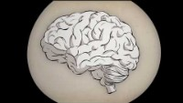
Video:
What is Addiction? (3:17 min)
Notes:
PLEASE NOTE THAT THE VIDEO MAY ONLY PLAY IN “SLIDE SHOW” MODE.
PLEASE ALLOW SEVERAL SECONDS FOR VIDEO TO LOAD.
Video Link: https://www.youtube.com/watch?v=MbOAKmzKmJo&t=1s

Slide 15
What are the effects of using Marijuana (Cannabis/THC)?
Group Activity
What Do You Think?
Notes:
Group Activity:
Ask the class “What are the effects of using marijuana?”
Write student answers on the board.
Proceed to show the next two slides.

Slide 16
What Can Happen When Someone
Uses Marijuana (Cannabis/THC)?
Potential Short-Term Problems
Marijuana use can interfere with:
Emotions (create anxiety, paranoia, panic)
Coordination
Memory
Thinking (create psychosis/distortion of reality)
Decision making
Concentration & Learning
Heart Rate
Scholastic, NIDA, NIH, Department of HHS
Notes:
Teacher Comments:
Every time a drug is used, including marijuana, there are risks.
No one can control the effects marijuana will have.
Effects for the same person using marijuana may be different over time.
Some effects such as concentration/learning problems, and paranoia (unreasonable fear)/panic can last for days after marijuana is used.
Scholastic, NIDA, NIH, Department of HHS. Real News About Drugs and Your Body, 2023
https://nida.nih.gov/sites/default/files/NIDA_YR20_INS1_StudentMagazine.pdf

Slide 17
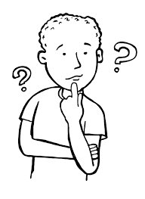
What Can Happen When Someone
Uses Marijuana (Cannabis/THC)?
Potential Long-Term Problems
Risk of Cannabis Use Disorder (Addiction)
Permanent brain changes
Depression & suicidal thoughts
Heart disease & stroke
Eating & sleeping problems
Breathing problems
Frequent & severe vomiting
School failure & drop out
Scholastic, NIDA, NIH, Department of HHS
CDC, UPI
Notes:
Teacher Comments:
There can be many negative long-term problems when someone uses marijuana.
Scholastic, NIDA, NIH, Department of HHS. Real News About Drugs and Your Body, 2023
https://nida.nih.gov/sites/default/files/NIDA_YR20_INS1_StudentMagazine.pdf
Centers for Disease Control and Prevention
https://www.cdc.gov/cannabis/health-effects/brain-health.html
https://www.upi.com/Health_News/2021/06/16/marijuana-teens-brain-development-study/4721623852022/

Slide 18
There is NO safe way to use marijuana..
Is Vaping Marijuana (Cannabis/THC)
Safer Than Smoking It?
Vaping high potency THC oils and concentrates increases the potential for addiction.
Devices used to vape THC can contain dangerous chemicals and metal particles from the device itself.
Pediatric Child Health Journal 2020
Notes:
This slide contains animations.
Each mouse click will advance to the next item on the slide.
Teacher Notes:
Though cannabis vaping is thought to generate fewer toxic emissions than cannabis smoking, it has been
associated with several cases of acute lung injury and often involves high-potency forms of cannabis,
exposing youth to several acute and long-term health risks.
Chadi N, Minato C, Stanwick R. Cannabis vaping: Understanding the health risks of a rapidly emerging trend.
Pediatric Child Health. 2020;25(Suppl 1):S16-S20. doi:10.1093/pch/pxaa016

Slide 19
The Dangers of Marijuana (Cannabis/THC) Edibles/Drinks
Marijuana edibles are foods (e.g. cookies, candy bars, brownies, etc.) or drinks which can have high and unpredictable levels of THC.
When marijuana edibles/drinks are used, the effects are often delayed.
The strongest effects of edibles may not be felt for several hours after the edible is eaten. When using THC drinks, the effects may not be felt for up to 45 minutes.
Given delayed effects, someone may eat or drink more to “get high”, leading to dangerous overdosing.
    Healthychildren.org
Notes:
This slide contains animations.
Each mouse click will advance to the next item on the slide.
https://www.healthychildren.org/English/ages-stages/teen/substance-abuse/Pages/Edible-Marijuana-Dangers.aspx

Slide 20
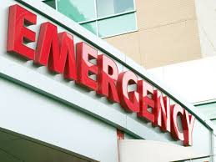
The
Dangers of Marijuana (Cannabis/THC) Edibles/ Drinks
Consuming Edibles/Drinks Can Result in Overdose Effects That Include:
  Intoxication/altered perception
  Anxiety/panic/paranoia
  Dizziness/weakness
  Slurred speech
  Poor coordination
  Increased heart rate/breathing problems
  Uncontrolled vomiting
Healthychildren.org
Notes:
This slide contains animations.
Each mouse click will advance to the next item on the slide.
https://www.healthychildren.org/English/ages-stages/teen/substance-abuse/Pages/Edible-Marijuana-Dangers.aspx

Slide 21

Marijuana (Cannabis/THC)
Affects Each Person Differently
Effects vary based on:
Biology (e.g., gender, weight, family history of addiction)
Strength of the marijuana (amount of THC)
Whether alcohol or other drugs are also used
Amount used and how it is used (smoked/vaped/eaten/drank)
Centers for Disease Control and Prevention
Notes:
Teacher Comments:
Some people feel nothing at all when they use marijuana.
Others may feel relaxed or "high.“
Some experience sudden feelings of anxiety and paranoid thoughts.
The effects can be unpredictable, especially when other drugs are mixed with it.
https://www.cdc.gov/cannabis/about/index.html

Slide 22
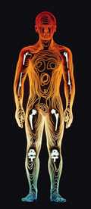
Marijuana (Cannabis/THC)
& Your Body
THC (Delta-9 tetrahydrocannabinol) rapidly passes from the lungs into the bloodstream, which carries the addictive chemical to organs throughout the body, including the brain.
THC is quickly absorbed by various organs in the body, including the brain.
THC stays in the body for a long period of time.
CDC
Notes:
This slide contains animations.
Each mouse click will advance to the next item on the slide.
https://www.cdc.gov/cannabis/about/index.html

Slide 23

Group Activity
How long do you think
THC stays in the body?
Notes:
Group Activity:
Have students answer the question, “How long does the THC in marijuana stay in a person’s body?”
Write their answers on the board.
Comment on longest time and shortest time suggested by the class.
(The next slide provides the answer.)

Slide 24

THC can be detected in the body
for up to 3 months.
The length of time THC remains in the body depends on how often it is used and the strength of the THC.
Web MD
Notes:
Teacher Comments:
Detection of THC in urine samples is not an exact science.
The number of days THC can be detected varies,
based on THC content and the metabolism of the person being tested.
Web MD
https://www.webmd.com/mental-health/addiction/what-to-know-about-how-long-marijuana-stays-in-your-system

Slide 25


Stopping Marijuana (Cannabis/THC)
Use Can Be Very Difficult
When people try to stop using marijuana they often:
Are irritable & angry
Are stressed & nervous
Have problems eating & sleeping
Have urges to keep using it
American Psychiatric Association
Notes:
American Psychiatric Association. (2022). Diagnostic and statistical manual of mental disorders (5th ed., text rev.).
https://doi.org/10.1176/appi.books.9780890425787

Slide 26

Marijuana (Cannabis/THC)
& the Brain
Your brain is not fully developed until you are about 25 years or older.
Marijuana use can damage the developing brain, seriously affecting the ability to think, learn, remember, pay attention, and make safe decisions.
CDC
Notes:
https://www.cdc.gov/cannabis/health-effects/brain-health.html

Slide 27

Video:
Guide to the Teen Brain (3:09 min)
Notes:
Before showing the video provide these instructions.
This video will inform us about the developing teen brain.
While we are watching, please write down one or two ideas that you think are important.
After seeing the video, I will ask you to share some of your thoughts.
PLEASE NOTE THAT THE VIDEO MAY ONLY PLAY IN “SLIDE SHOW” MODE.
PLEASE ALLOW SEVERAL SECONDS FOR THE VIDEO TO LOAD.
National Institute on Drug Abuse
Video Link: https://www.youtube.com/watch?v=EpfnDijz2d8&t=1s

Slide 28
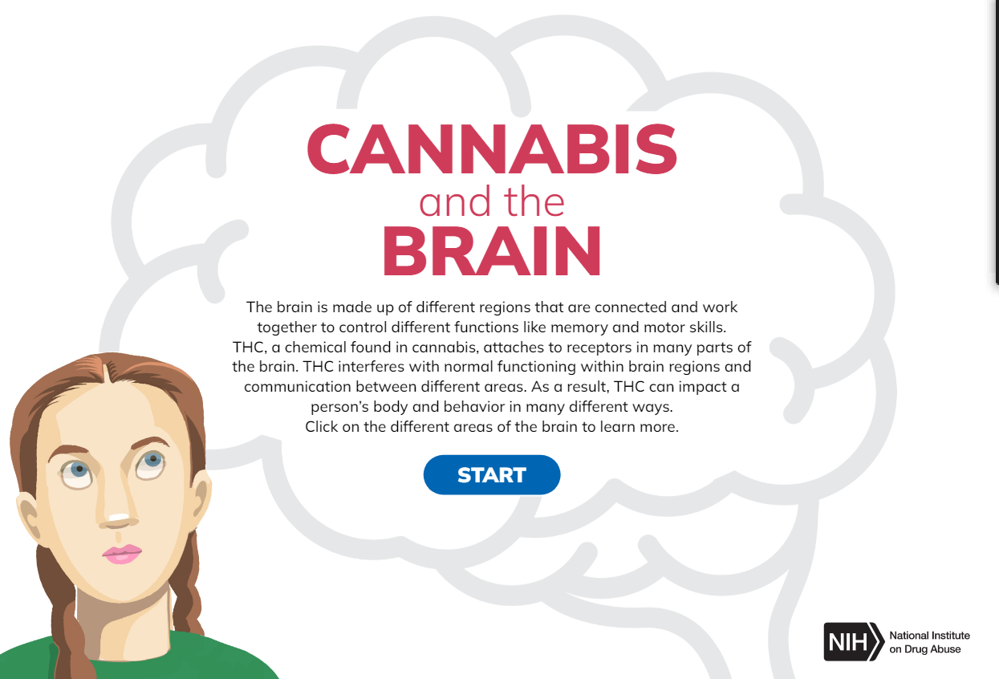
Group Activity
Cannabis and the Brain
Notes:
Group Activity:
Click on the photo in the slide to access the information about the effects of marijuana on the brain.
When each of the red dots turns blue, you know you have completed each section of the brain.
This link can also be used to get to this activity.
https://nida.nih.gov/themes/custom/solstice/interactive/cannabis/
To simplify the presentation, the parts of the brain are summarized below.
Cerebrum- the area that controls the ability to think, plan, solve problems, and make decisions.
Basal Ganglia – area involved in movement, thinking, and emotion.
Limbic System - area involved in memory and emotion processing.
Brain Stem – area involved in vital life functions.
Cerebellum – area involved in motor skills, such as balance and coordination, and plays an important role in the perception of time.
When the screen says GREAT JOB, return to this PowerPoint.

Slide 29
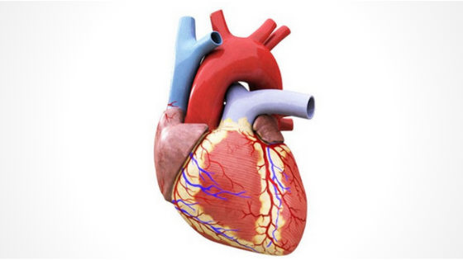
Marijuana (Cannabis/THC)
& the Heart
Marijuana can make the heartbeat faster and raise blood pressure immediately after use.​
Marijuana use can lead to increased risk of stroke and heart disease.
CDC
Notes:
Teacher Comments:
Increased heart rate is one of the reasons people using marijuana go to the emergency room because
they fear a heart attack.
Teacher Notes:​​
Heart attack risk may be related to increased heart rate, as well as the effects of marijuana on heart rhythms,
causing quick and irregular heart beats. ​
This can be a frightening experience for the person using marijuana.​
​
Centers for Disease Control and Prevention​
https://www.cdc.gov/cannabis/health-effects/heart-health.html

Slide 30
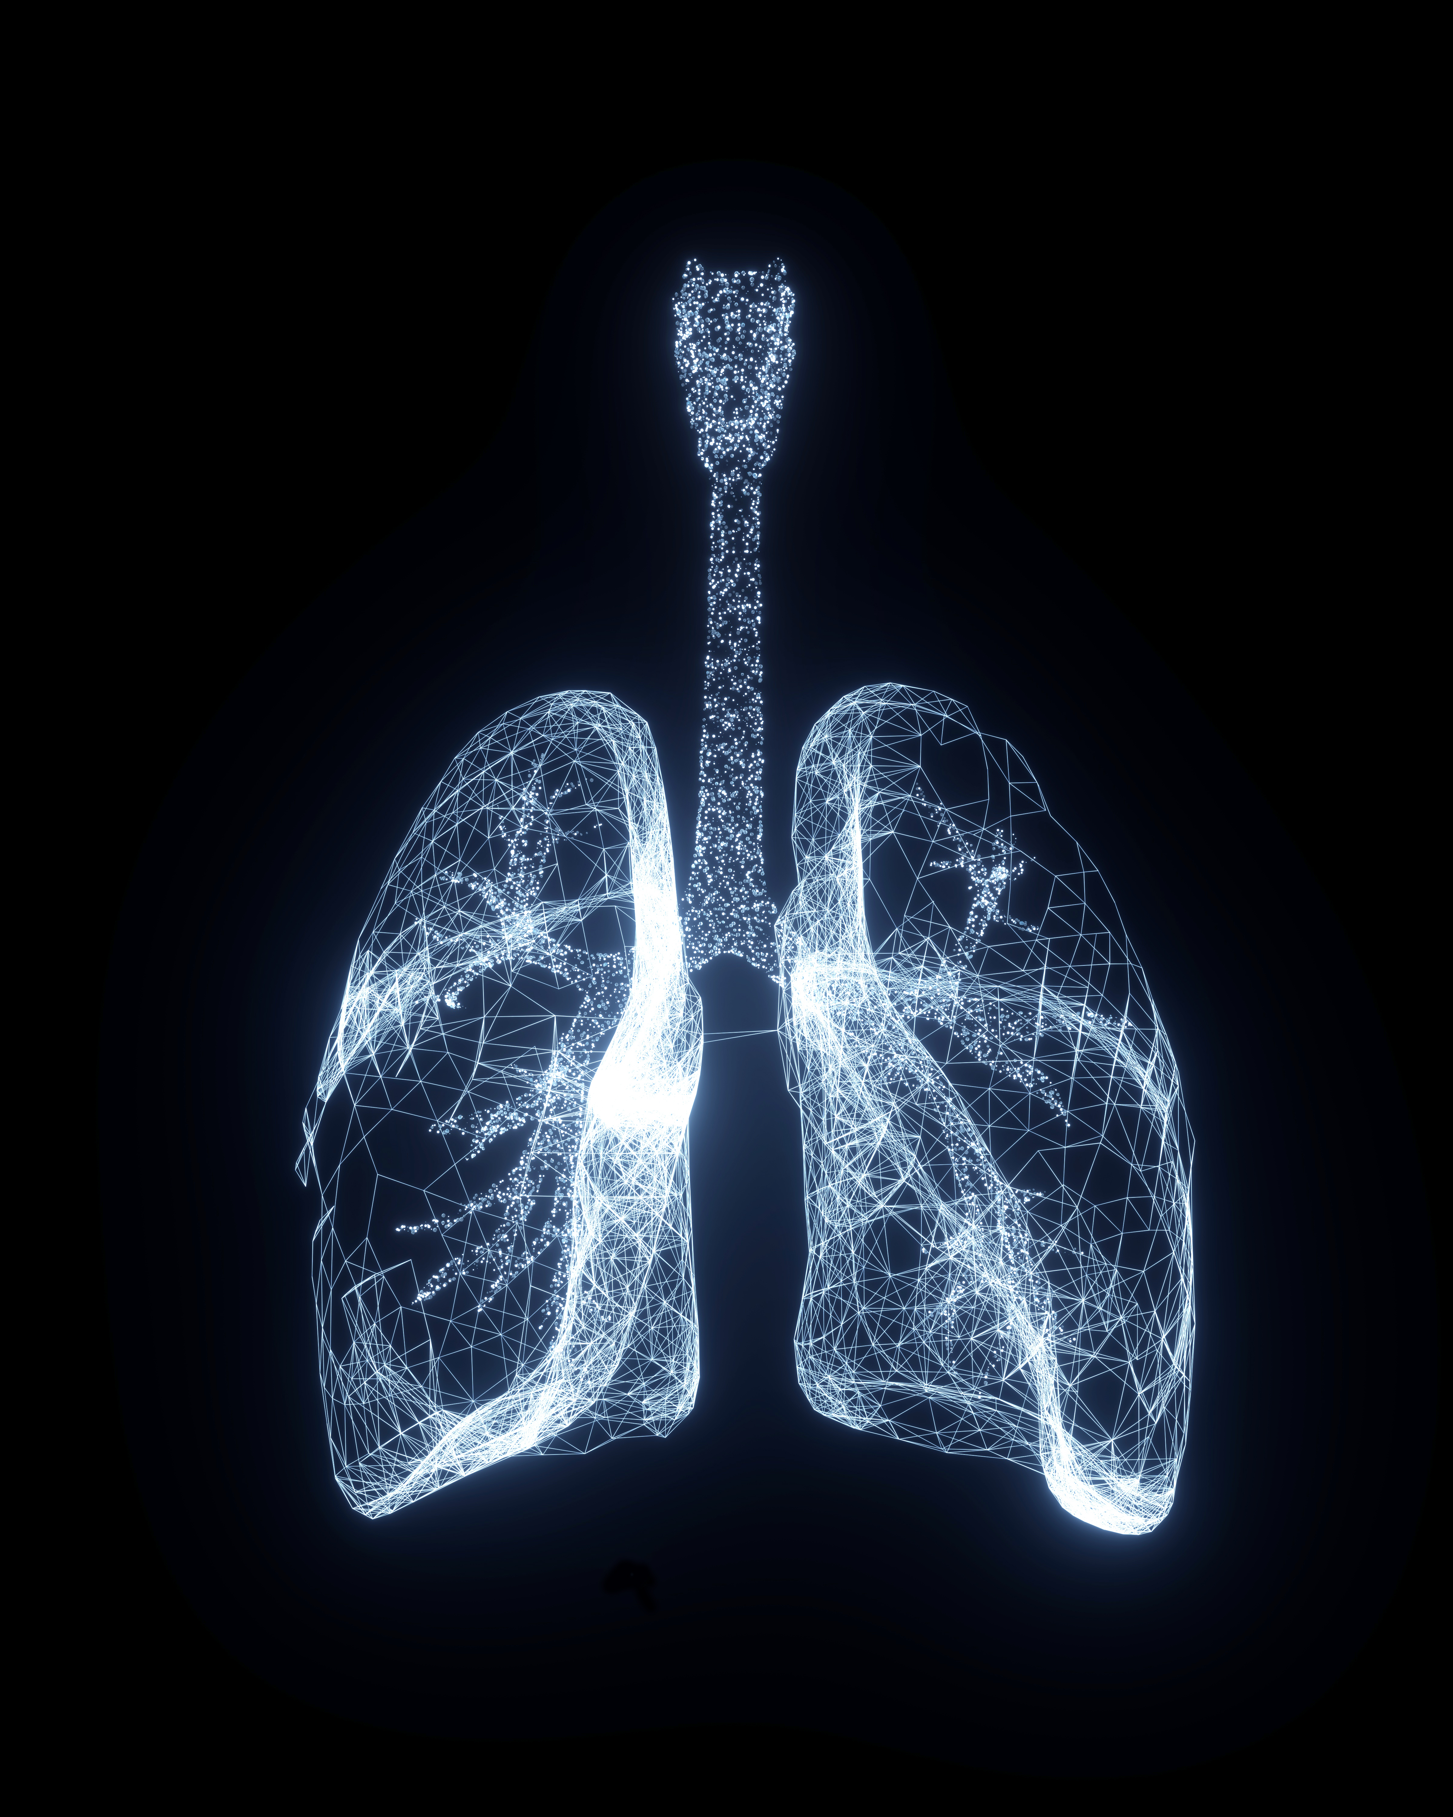
Marijuana (Cannabis/THC)
& the Lungs
Research has shown that vaping marijuana can cause lung damage.
Teens that vape marijuana are more likely to have breathing problems.
University of Michigan
Notes:
Vaping marijuana associated with more symptoms of lung damage than vaping or smoking nicotine
https://news.umich.edu/vaping-marijuana-associated-with-more-symptoms-of-lung-damage-than-vaping-or-smoking-nicotine/

Slide 31
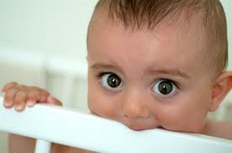
Can Marijuana (Cannabis/THC)
Use During Pregnancy
Harm the Developing Baby?
YES!
Research shows that children of mothers who used marijuana during pregnancy are more likely to have trouble with problem-solving, memory, sleep, behavior, learning, and attention, which can be
life-long.
JAMA
Notes:
Teacher Comments:
Even low doses of THC used during pregnancy can have profound and long-lasting consequences for both the
brain and behavior of a child.
Teacher Notes:
Research has shown that some babies born to women who used marijuana
during their pregnancies display altered responses to visual stimuli, tremors, and a high-pitched cry, which suggest
problems with neurological development.
In school, marijuana-exposed children are more likely to show gaps in problem solving skills, memory, and the ability
to remain attentive. More research is needed, however, to determine the drug-specific factors from the environmental ones.
Paul SE, et al., Associations Between Prenatal Cannabis Exposure and Childhood Outcomes: Results From the ABCD Study.
JAMA Psychiatry. 2020 Sep 23:e202902. doi: 10.1001/jamapsychiatry.2020.2902.
https://pubmed.ncbi.nlm.nih.gov/32965490/

Slide 32

Marijuana (Cannabis/THC) Use in Pregnancy Increases the Risk of:
Early birth
Decreased birth weight (less than 5.5 pounds)
Smaller head size
Need for intensive care after birth
JAMA
Notes:
Paul SE, et al., Associations Between Prenatal Cannabis Exposure and Childhood Outcomes: Results From the ABCD Study.
JAMA Psychiatry. 2020 Sep 23:e202902. doi: 10.1001/jamapsychiatry.2020.2902.
https://pubmed.ncbi.nlm.nih.gov/32965490/

Slide 33
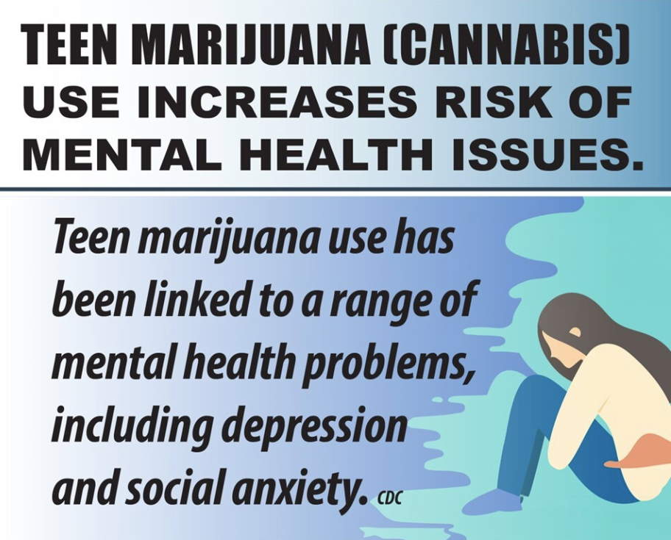
Marijuana (Cannabis/THC)
& Mental Health
CDC
Notes:
Teacher Comments:
Anxiety and depression are the most common disorders of childhood.
Regular use, particularly of high potency marijuana, has been linked to these and other mental health disorders.
Much more research needs to be done to discover the connection between marijuana and mental health.
https://www.cdc.gov/cannabis/health-effects/cannabis-and-teens.html

Slide 34
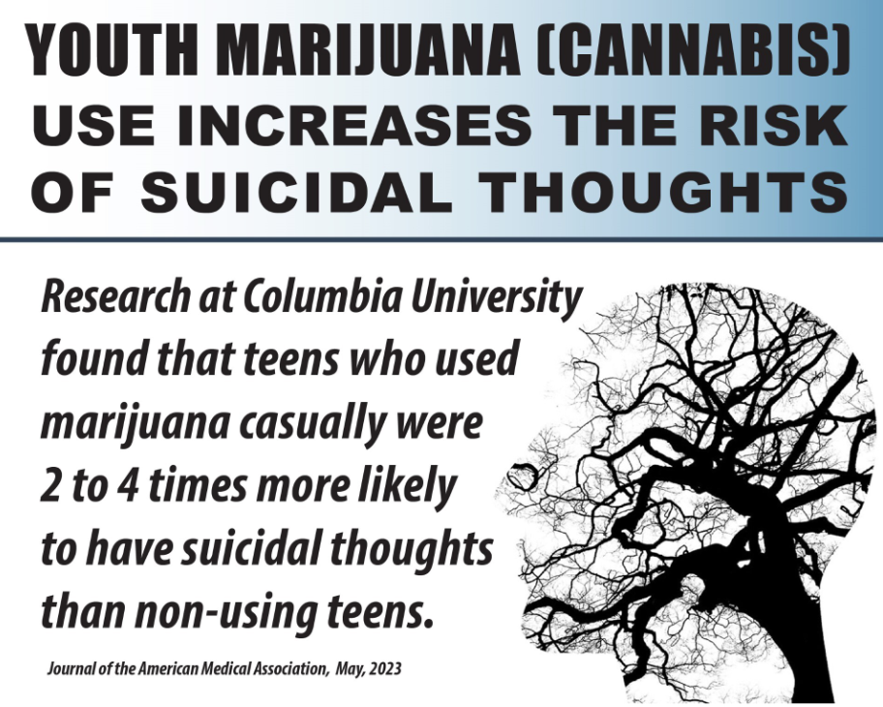
Marijuana (Cannabis/THC)
& Mental Health
Notes:
Teacher Comments:
A reminder about suicidal thoughts –
if you or anyone you know is experiencing suicidal thoughts it is very important to talk with an adult you trust.
https://www.columbiapsychiatry.org/news/recreational-cannabis-use-among-u-s-adolescents-poses-risk-adverse-mental-health-and-life-outcomes

Slide 35

Marijuana (Cannabis/THC)
& Acute Panic (Anxiety)
Some users of high potency marijuana experience acute panic. National Institutes of Health
Since it was legalized in Michigan for adult use, there has been an increase in visits to emergency rooms because of anxiety/panic reactions. Keung et al, Cureus, 2023
Notes:
Teacher Comments:
Episodes of panic involve extremely high levels of anxiety.
https://medlineplus.gov/ency/article/000952.htm (National Institutes of Health)
https://pubmed.ncbi.nlm.nih.gov/37252542/
Keung MY, Leach E, Kreuser K, et al. Cannabis-Induced Anxiety Disorder in the Emergency Department. Cureus. 2023;15(4):e38158.
Published 2023 Apr 26. doi:10.7759/cureus.38158

Slide 36
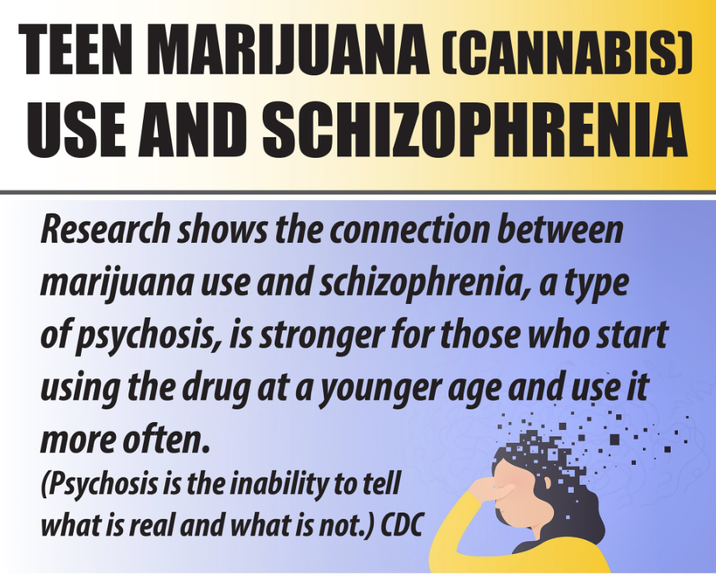
Marijuana (Cannabis/THC)
& Mental Health
Notes:
https://www.cdc.gov/cannabis/about/index.html

Slide 37

Marijuana (Cannabis/THC)
& School
The effects of marijuana use
on the developing brain can negatively impact
school performance.
Research shows that teens that use marijuana are more likely to drop out of high school.
SAMHSA
Notes:
https://www.getsmartaboutdrugs.gov/content/school-failure

Slide 38

Marijuana (Cannabis/THC)
& College Success
Students who use marijuana are
MUCH LESS LIKELY to get a college degree.
CDC
Research has shown the more frequently college students use marijuana, the lower their GPA tends to be, the more they report skipping class, and there is a greater likelihood of dropping out or taking longer to graduate.
Inside Higher Ed 2023
Notes:
https://www.cdc.gov/cannabis/health-effects/cannabis-and-teens.html​
​
https://www.insidehighered.com/news/2023/02/23/study-increased-marijuana-use-college-campuses#:~:text=Research%20has%20shown%20that%20the,it%20takes%20them%20to%20graduate.

Slide 39

Financial Aid & College Scholarships
Colleges have different requirements for scholarships.
Some colleges and universities may not allow a student to apply for or keep a scholarship if he/she has a conviction for a drug offense.
Don’t risk being unable to go to the school of your choice or losing your scholarship.
Just Think Twice, US Government
Notes:
Teacher Comments:
As part of the Free Application for Federal Student Aid (FAFSA) process, students convicted of a drug offense must complete an eligibility worksheet that will determine if they are eligible, partially eligible, or ineligible for student aid.
https://www.justthinktwice.gov/you-might-lose-your-student-loans-or-scholarship-drug-use

Slide 40


Marijuana (Cannabis/THC) use can slam the door to your future!
Notes:
This slide is automated to produce the sound of a door slamming.
Teacher Comments:
The use of any drug, including marijuana, has the potential of creating negative lifelong changes.

Slide 41
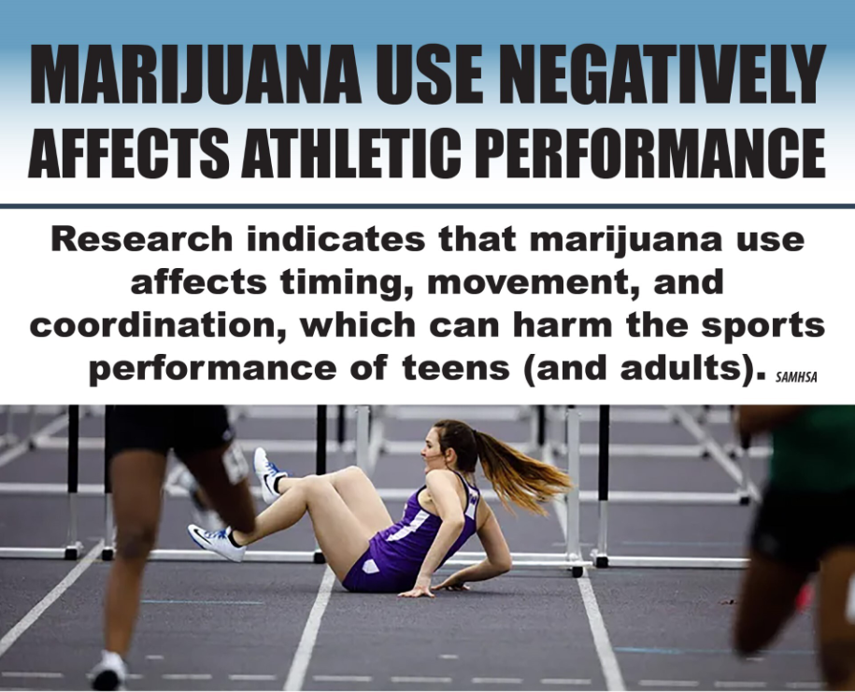
Group Activity
Marijuana (Cannabis/THC)
& Sports
Notes:
Group Activity:​
Ask: ​
How many of you are part of a sports team?​
How many hours a week do you practice during your season?​
How important is it for you to be a good athlete?​
​
Let’s review the effects of marijuana use on athletic performance.​
​
Marijuana use:​
Decreases eye-hand coordination​
Slows reaction time​
Reduces motor coordination​
Slows reflexes​
Impairs tracking ability and perceptual accuracy​
Impairs concentration, and time appears to move more slowly​
Causes short and long-term memory loss, "I can't remember the plays, coach"​
Creates difficulty with thinking and problem solving, ​
Decreases motivation to perform and/or give maximum effort​
​
Staying away from marijuana helps your team succeed.​
​
https://www.samhsa.gov/marijuana​
​
https://www.ncaa.org/news/2019/10/10/emerging-science-on-cannabis-marijuana-implications-for-student-athletes.aspx
Teacher Comments:
Marijuana can substantially decrease performance, given its proven negative effects on the mental and physical skills involved in playing a sport.
SAMHSA: Know the Risks of Marijuana 2024
https://www.samhsa.gov/marijuana

Slide 42
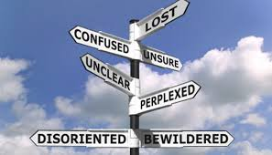
Marijuana (Cannabis/THC)
& Daily Life
Longtime marijuana users report:
Less life satisfaction
Relationship problems
Reduced educational outcomes
Less career success
        SAMHSA
Notes:
This slide contains animations.
Each mouse click will advance to the next item on the slide.
https://www.samhsa.gov/marijuana

Slide 43
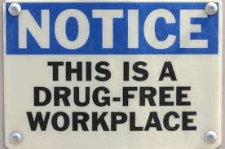
Marijuana (Cannabis/THC)
& Employment in Michigan
Even though marijuana use is legal for adults in Michigan, someone can be fired or not hired for a positive drug test if it violates the policy
of the workplace.
MICHIGAN REGULATION AND TAXATION OF MARIHUANA ACT
Notes:
Teacher Note:
Michigan Marijuana Laws use an “h” instead of “j” to spell marijuana.
MICHIGAN REGULATION AND TAXATION OF MARIHUANA ACT
333.27954
Sec. 4. 3. This act does not require an employer to permit or accommodate conduct otherwise allowed by this act in any workplace or on the employer's property. This act does not prohibit an employer from disciplining an employee for violation of a workplace drug policy or for working while under the influence of marihuana. This act does not prevent an employer from refusing to hire, discharging, disciplining, or otherwise taking an adverse employment action against a person with respect to hire, tenure, terms, conditions, or privileges of employment because of that person's violation of a workplace drug policy or because that person was working while under the influence of marihuana.
Michigan Proposal 1, Marijuana Legalization Initiative (2018)
333.27954 Section 4 State of Michigan

Slide 44

What jobs could be negatively affected by Marijuana (Cannabis/THC) use?
Group Activity
Notes:
Group Activity:
Ask the class this question. What jobs could be negatively affected by Marijuana (Cannabis/THC) use?
Write the results of the brainstorm activity on the board.
Proceed to next slide.

Slide 45
MICHIGAN: People who work in these areas risk losing their state license if it is found that marijuana use negatively affects their job.
Acupuncture
Athletic Training
Audiology
Behavior Analysts
Chiropractic
Counseling
Dentistry
Marriage and Family Therapy
Massage Therapy
Medicine
Midwifery
Nursing
Nursing Home Administrator
Occupational Therapy
Optometry
Osteopathic Medicine and Surgery
Pharmacy
Physical Therapy
Physician’s Assistant
Podiatric Medicine and Surgery
Psychology
Respiratory Care
Sanitarian
Social Work
Speech-Language Pathology
Veterinary Medicine
Michigan License and Regulatory Affairs
Notes:
Group Activity:
Ask the class “Would you want someone under the influence of marijuana to be your Doctor? Dentist? Nurse? Pharmacist? Etc.
Why or why not?”
https://www.michigan.gov/lara/bureau-list/bpl

Slide 46

People who work in these areas also risk their job if they use marijuana.
ALL Federal Employees
Michigan Department of Transportation:
Truck drivers, pilots, school bus drivers, train engineers, aircraft maintenance personnel, and others.
Those needing a commercial driver’s license
Michigan Law Enforcement:
Local police, state troopers, corrections officers
Notes:
U.S. Department of Transportation:
https://www.transportation.gov/odapc/dot-recreational-marijuana-notice
https://www.transportation.gov/odapc/part40
Michigan Civil Service Commission:
https://www.michigan.gov/-/media/Project/Websites/mdcs/REGS/Reg207.pdf?rev=33f1841b275c42dab813d344dc9c53ba
Michigan Drug Testing Laws:
https://michigancannabis.org/drug-testing-law

Slide 47
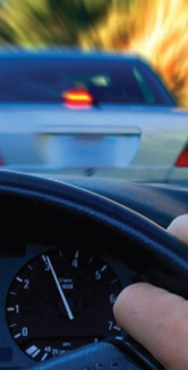
Marijuana (Cannabis/ THC) & Driving
Marijuana is involved in many fatal car crashes in Michigan.
People who drive under the influence of marijuana can experience dangerous effects, including:
Slower reaction time
Lane weaving
Decreased coordination
Difficulty reacting to signals
and sounds on the road
University of Michigan 2025
SAMHSA
Notes:
University of Michigan Injury Prevention Center. Impact of Recreational Cannabis Legalization in Michigan.
University of Michigan. Ann Arbor, MI. April 2025.
https://www.samhsa.gov/marijuana

Slide 48

Marijuana (THC/Cannabis)
& Driving
Driving under the influence (DUI) laws do not just apply to alcohol. Driving under the influence of all other drugs, including marijuana, is dangerous and illegal.
Did you know?
It is illegal
for marijuana
to be used
by passengers
in a car.
4200 Cannabis and Driving Brochure
Notes:
Teacher Comments:
After alcohol, marijuana is the drug most often associated with impaired driving.
https://www.michigan.gov/msp/-/media/Project/Websites/msp/ohsp/1_March-2023/4200-Cannabis-and-Driving-brochure.pdf?rev=d691b3f17f184cea9444c10a5aa5a2de

Slide 49
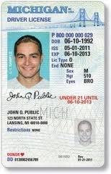
Even though commercial marijuana is legal for adults (21+) in Michigan, there are serious consequences for ANYONE that DRIVES UNDER THE INFLUENCE of Marijuana (Cannabis/THC).
The penalties are the same as those imposed for operating under the influence of alcohol. These penalties can include:
Up to 93 days in jail
Up to a $500 fine
License suspension
Six points on a person’s driving record
There are even greater penalties if a driver has minors in the vehicle.
4200 Cannabis and Driving Brochure
Notes:
Teacher Notes:
If you are asked about points on a driver’s license you can explain as follows:
Each traffic violation or crime is worth a certain number of points, which is determined by the Michigan Vehicle Code.
Minor offenses are often two points, while serious crimes are up to six points.
Every point placed on your driver record stays there for two years from the date of your conviction.
If you plead guilty to a traffic violation, or you are found guilty by a court, then you will have driver’s license points assigned, and they will stay there the entire two years.
Accumulation of points can result in increased insurance cost, suspension of license and other consequences.
https://www.michigan.gov/msp/-/media/Project/Websites/msp/ohsp/1_March-2023/4200-Cannabis-and-Driving-brochure.pdf?rev=d691b3f17f184cea9444c10a5aa5a2de
http://www.mymichigandefenselawyer.com/michigan-criminal-laws/marijuana-possession/

Slide 50
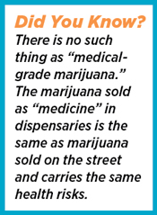
Marijuana (Cannabis/THC) is
NOT Medicine
Some people use marijuana believing it helps with a medical condition. The FDA warns that the use of any form of marijuana, aside from the products they have tested (e.g. Marinol, Sativex, Epidiolex), can result in unintended consequences and serious
safety risks.
Notes:
Teacher Comments:
The U.S. Food and Drug Administration (FDA) has approved some medications made from the cannabis plant, e.g., Marinol, Sativex, and Epidiolex, that contain chemicals from the plant but are not intended to create a “high” for the user. Cannabis and/or cannabis-derived products that are not FDA approved are being used by some people to treat symptoms of medical conditions including HIV stage 3, epilepsy, neuropathic pain, spasticity associated with multiple sclerosis, and cancer and chemotherapy-induced nausea. The use of unapproved cannabis and cannabis-derived products, however, can have unpredictable and unintended consequences, including serious safety risks.
Teacher Notes:
Caregivers and patients can be confident that FDA-approved drugs have been carefully evaluated for safety, efficacy, and quality, and are monitored by the FDA once they are on the market. Also, there has been no FDA review of data from rigorous clinical trials to support that these unapproved products are safe and efficacious for the various therapeutic uses for which they are being used.
https://www.fda.gov/news-events/public-health-focus/fda-and-cannabis-research-and-drug-approval-process
http://www.scholastic.com/smp/pdfs/nida/NIDA10-INS3_Stu%20Mag.pdf

Slide 51
Some Facts about Michigan’s
Medical Marihuana Act
  Using ANY marijuana, including medical,
  is NOT allowed:
  While operating a car or any other motor vehicle, aircraft, or motorboat
  In a public place or on any form of public transportation, including a school bus
  In schools
  In a correctional facility
Michigan Medical Marihuana Act 2008
Notes:
Teacher Comments:
Sometimes people believe that there are no restrictions for “medical marijuana” use in the community.
This is not true.
Michigan Medical Marihuana Act 2008
http://www.legislature.mi.gov/(S(gpaghb2gfee2j0aattngi4eu))/
mileg.aspx?page=getobject&objectname=mcl-Initiated-Law-1-of-2008&query
=on&highlight=medical%20AND%20marihuana

Slide 52
What about CBD?
CBD products are widely marketed, claiming many different uses.
CBD products found in stores are NOT approved by the U.S. Food and Drug Administration as treatment for any medical conditions.
American Academy of Child and Adolescent Psychiatry
Notes:
Teacher Notes:
Is cannabidiol (CBD) medicine?
As of 2024, Scientists are still learning about how CBD affects the body.
The U.S. Food and Drug Administration (FDA) approved Epidiolex, a medicine that contains purified CBD from cannabis plants, to help treat seizure disorders.
The FDA has concluded that this drug is safe and effective for the intended use.
However, other marketed uses of CBD are not FDA approved.
There is ongoing research on the use of CBD-containing products for conditions such as epilepsy, PTSD, Tourette’s disorder, pain, and other diagnoses. For now (2024), the use of CBD is only FDA-approved in children for specific forms of epilepsy and in adults for chemotherapy induced nausea and vomiting. At this time, there is not enough evidence to recommend CBD for other uses in children and adolescents including the treatment of autism and other developmental disorders. The approved CBD requires a prescription. Many stores sell CBD products. However, there are no safety and quality requirements for non-prescription CBD. They may have harmful additives or interfere with prescription medication.
https://www.aacap.org/AACAP/Families_and_Youth/Facts_for_Families/FFF-Guide/Marijuana-and-Teens-106.aspx
For more information visit SAMHSA: https://store.samhsa.gov/sites/default/files/pep22-06-04-003.pdf

Slide 53

Marijuana (Cannabis/THC) Matters:
Let’s Sum It Up!
Any time someone uses drugs, they risk serious and unpredictable physical and emotional damage.
Drug use, including use of marijuana, can have significant negative effects on family relationships, mental health, friendships, school,
athletic performance,
and someone’s future.
Notes:
Teacher Notes:
This slide presents a summary of key issues related to teen marijuana use.

Slide 54

Marijuana (Cannabis/THC) Matters:
Let’s Sum It Up!
It’s important to find ways to manage feelings, deal with stress, and have fun without using drugs.
MOST TEENS DO NOT USE MARIJUANA, ALCOHOL, VAPE, OR OTHER DRUGS.
Notes:
Teacher Notes:
This slide presents a summary of key issues related to teen marijuana use.
If you would like to provide your students with an informational sheet on managing difficult emotions,
it can be accessed on the Kids Health website: https://kidshealth.org/en/teens/stressful-feelings.prt-en.html

Slide 55

Get The Facts…
For more research-based information:
www.cvcoalition.org
www.drugabuse.gov
www.teens.drugabuse.gov
www.cadca.org
www.nimh.nih.gov
www.niaaa.nih.gov
www.fda.gov
Notes:
Teacher Comments:​
There is much misinformation about marijuana. To learn the facts, you can visit any of these websites. ​
Check out the games, blogs, and interactive quizzes for your age.​
​
Optional Assignment:​
Give your students 10 minutes to explore one of these options and report back what they find.

Slide 56

Information Provided By:
www.cvcoalition.org
Notes:
The Chippewa Valley Coalition for Youth and Families is a school-community coalition in
mid-Macomb County, Michigan. We provide research-based prevention lessons on marijuana use for
middle school students and vaping. These are also available free of charge on our website.

