Slide 1
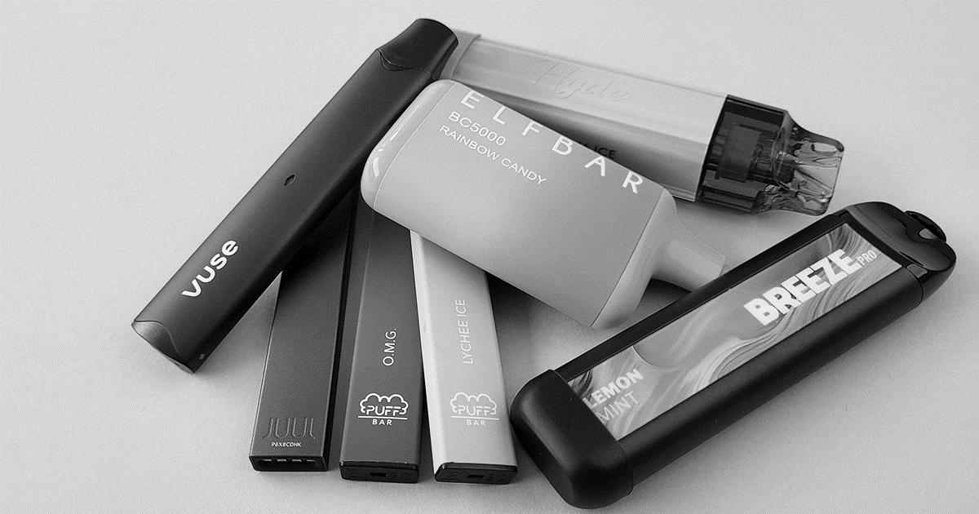
Know the Risks
Photo Source: TruthInitiative.org
Vaping & Your Health
Notes:
IN THE FOLLOWING SLIDES, SUGGESTED COMMENTS, AND DISCUSSION PROMPTS ARE PROVIDED IN BOLD TYPE.
Most slides contain a notes section with discussion questions or information for you to share with your students. There are 3 embedded videos.
The slides and instructional notes and are also available in PDF form found in the supplemental materials for this PowerPoint lesson.
This vape prevention lesson, - Know the Risks: Vaping and Your Health - was developed by the Chippewa Valley Coalition for Youth and Families
in partnership with ACCESS, Macomb County Office of Substance Abuse, CARE of Southeast Michigan, Macomb Family Services and the Macomb County Health Department.
It was created in response to local, state and national data that shows a dramatic increase in recent years of youth use of vape products.
This lesson was designed to be delivered in one class session.
The lesson was piloted in Chippewa Valley Schools in Macomb County, Michigan.
It was reviewed by Sara Orris, School Health Education/Homeless Consultant at the Macomb Intermediate School District and found compatible with the Michigan Model for Health.
UPDATED AUGUST, 2025

Slide 2
After This Lesson, You Should Be Able To:
Discuss health risks of vaping, including addiction.
Identify common ingredients in vapes and vape liquids, including nicotine.
Understand how companies use advertising to try to influence you to vape.
Recognize the risks of vaping marijuana.
Make an informed decision about vaping.

Slide 3
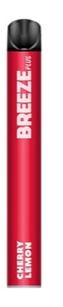
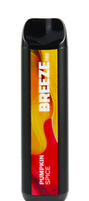
Did You Know….?
…vaping devices are considered a tobacco product, like “regular” smoked cigarettes.
…vape products cannot be legally sold to anyone under the age of 21.
…flavored vape cartridges (besides tobacco and menthol) are banned by the U.S. Food and Drug Administration (FDA).
Notes:
SUGGESTED COMMENTS:
-As of August 8th, 2016, the Food and Drug Administration (FDA), part of the U.S. government, regulates vape products as tobacco products.
This means that the rules for selling vape products are the same as those for selling smokeless tobacco, cigarettes and cigars.
These rules include the following:
-It is illegal for anyone under 21 years old to purchase vape products (including vape liquid refills, batteries or tanks).
-Vape product packages must include health warning labels, like cigarettes.
-Stores cannot provide free samples of vape products.
-There is no requirement that the ingredient list be included on the label.
Teacher’s Note: In December of 2019, a federal law was signed raising the age to purchase tobacco products from 18 to 21, including cigarettes and vape devices.
The state of Michigan revised Michigan’s tobacco law to be in line with federal law in July of 2022. (fda.gov)
Suggested Question: Why would lawmakers change the tobacco purchase age to 21?

Slide 4
High School Use
Monitoring the Future National Survey 2020-2024
Percentage of high school students (grades 10 & 12 combined) that used cigarettes or vapes during the past 30 days
Notes:
Monitoring the Future is a yearly national survey conducted by the University of Michigan with 8th, 10th and 12th grade students.
For the purposes of this slide, an average of 10th and 12th grade data was used to generate high school data. www.monitoringthefuture.org
SUGGESTED COMMENTS:
-When we look at this slide, it is important to remember, If you are NOT vaping, you are in the MAJORITY.
-In 2024, the most recent data from the Monitoring the Future survey,
12.4% of 10th and 12th graders in the United States were current vape users.
That means that almost 88% of high school students DO NOT VAPE.
In fact, high school use of cigarettes and vapes has dropped overall since 2020.
Still, vapes are the most widely used tobacco product among teens.
-It is important for young people to understand what vapes are and why they are dangerous.
https://monitoringthefuture.org/data/bx-by/

Slide 5
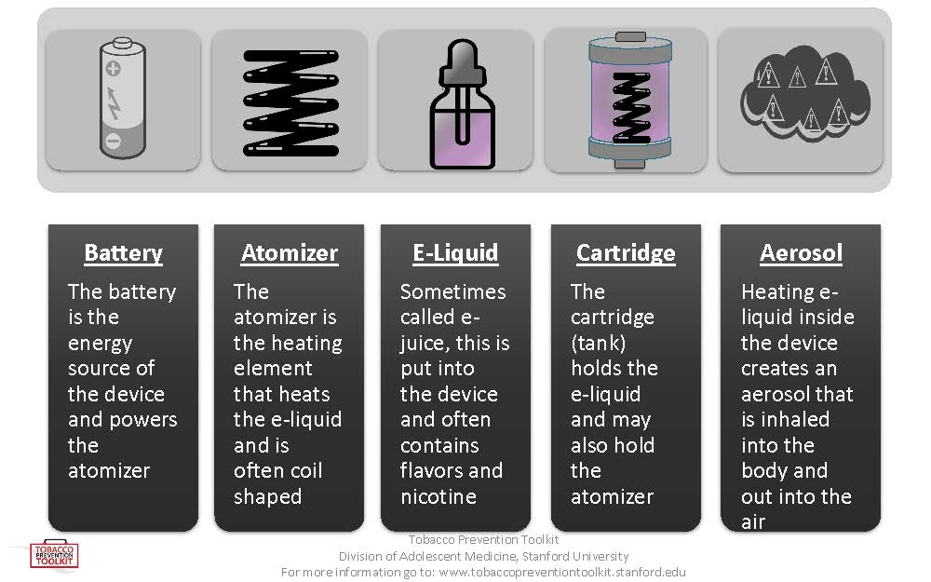
Parts of a Vape Device
Notes:
SUGGESTED COMMENTS:
-Vape devices come in many shapes and sizes, but they generally have the same parts.

Slide 6

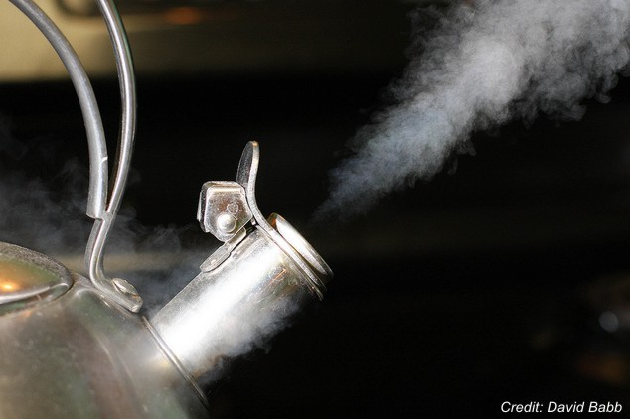
It’s Not Just Vapor--
It’s an AEROSOL
vs.
VAPOR:
It’s called vape, but that’s misleading.
Vapor is a substance suspended in the air.
AEROSOL:
A suspension of fine solid
or liquid particles in gas.
Stanford Medicine Tobacco Prevention Toolkit
Notes:
SUGGESTED COMMENTS:
-Many people think that a vape produces “vapor”. It is actually a mix of chemicals called an “aerosol” that is produced by heating the vape device and liquid inside.
Aerosol from vape includes particles of nicotine, propylene glycol, flavors, and other chemicals.
-Breathing in “second-hand” aerosol exposes others to chemicals and heavy metals.

Slide 7
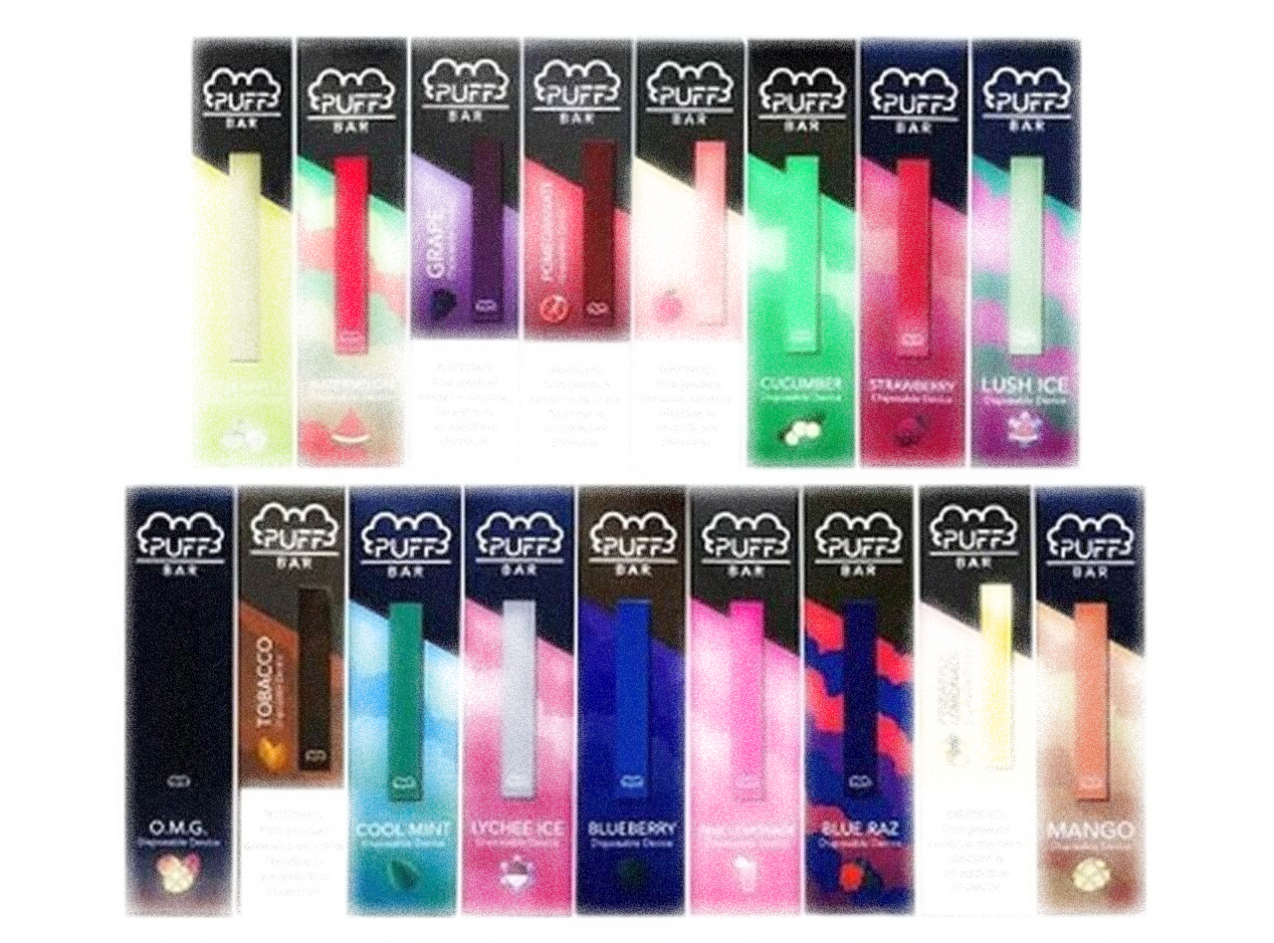
What Do You Think is in
Vape Liquid?
Notes:
DISCUSSION QUESTION: What Do You Think is in the Liquid Inside of a Vape?
-Write student responses on board.
-The content of vape liquids will be listed on the next two slides.

Slide 8
What's REALLY in Vape Liquid?
  Nicotine
  A highly addictive chemical found in most vapes and cigarettes.
More people in the United States are addicted to nicotine than to any other drug.
85% percent of people who try to quit smoking cigarettes on their own are unsuccessful.
CDC.gov
Notes:
SUGGESTED COMMENTS:
-Nicotine is the addictive chemical found in cigarettes. It can also be found in almost
every vape product and vape liquid, even some products claiming to be “nicotine-free”.
-Nicotine is one of the most addictive drugs in existence.
-We’ll discuss addiction in more detail later in the presentation.

Slide 9
What Else is in Vape Liquid?
  Propylene Glycol – Liquid used in smoke machines
  Vegetable Glycerin – Liquid used to make soap
  Flavorings – Chemicals used to make flavors like mango, mint and mixed fruit
  Chemicals created by overheating vape liquid, including formaldehyde, acrolein and acetaldehyde (chemicals also found in cigarette smoke)
American Lung Association
Notes:
SUGGESTED COMMENTS :
-Vape companies have to submit their ingredient list to the FDA, but they do not
have to list ingredients on their labels.
-Even flavorings that are safe to eat, like vanilla, can be dangerous to your lungs
when inhaled.
-A flavoring chemical called diacetyl that has been used in vape liquids causes
the permanent lung disease, “popcorn lung”.
-Many of the harmful chemicals in cigarette smoke are the result of a
chemical reaction that results from burning tobacco.
A similar reaction happens when vape liquids are heated to high temperatures.

Slide 10

Video: Behind the Haze: See Through
Notes:
PLEASE NOTE THAT VIDEO MAY ONLY PLAY WHEN PRESENTATION IS IN “SLIDE SHOW” MODE. PLEASE ALLOW SEVERAL SECONDS FOR VIDEO TO LOAD.
Video Link: https://www.youtube.com/watch?v=yH0nDpBwnwM
SUGGESTED COMMENT:
-Now we’ll see a short video about the chemicals found in vape products.

Slide 11

Vaping and Your Health
Vaping is a significant health risk.
Research has found proven health dangers from vaping.
These dangers include ADDICTION, as well as various other effects.
Notes:
SUGGESTED COMMENTS:
-Vaping is still a relatively new phenomenon. The research is limited on the negative effects of vaping on the human body, and on youth specifically.
-We know that cigarettes pose serious health dangers because they have been used and researched for over 150 years. For many years, smokers thought smoking was safe.
-Generations of cigarette smokers started smoking before we understood the risks and became lifetime tobacco users.
-People who vape may be exposing themselves to health risks that will not be discovered for many years.

Slide 12

What is ADDICTION?
The brain is “hijacked” by a drug—which means it’s very hard to quit.
National Institute on Drug Abuse
Notes:
SUGGESTED COMMENTS:
-Addiction is a very strong urge to do something that is hard to control or stop.
Even after the first or second use of vape products, you could become addicted to them.

Slide 13
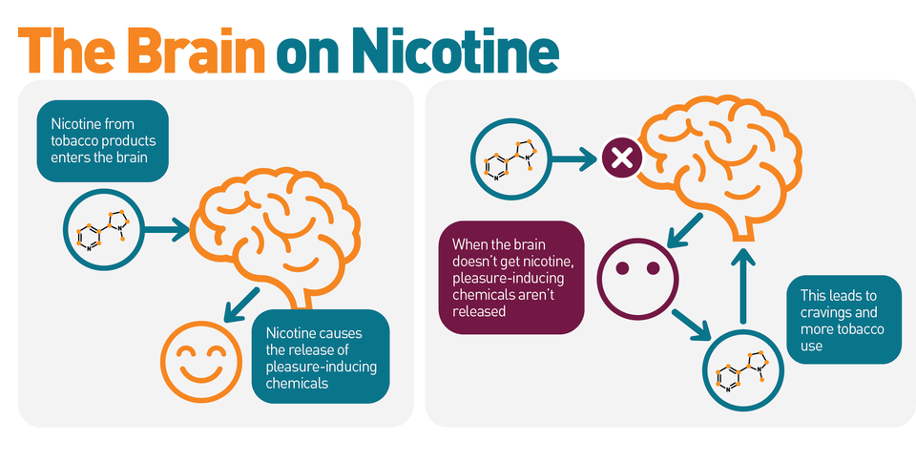
Vaping and Addiction
Truthinitiative.org
Notes:
SUGGESTED COMMENTS:
-Addiction is often called a “cycle”. The cycle starts when vaping causes the brain to receive nicotine.
Nicotine can produce short-term positive feelings in the brain. Once these positive feelings wear off, the brain craves more nicotine and the cycle repeats.
Over time the brain will need more and more nicotine, causing greater addiction.

Slide 14
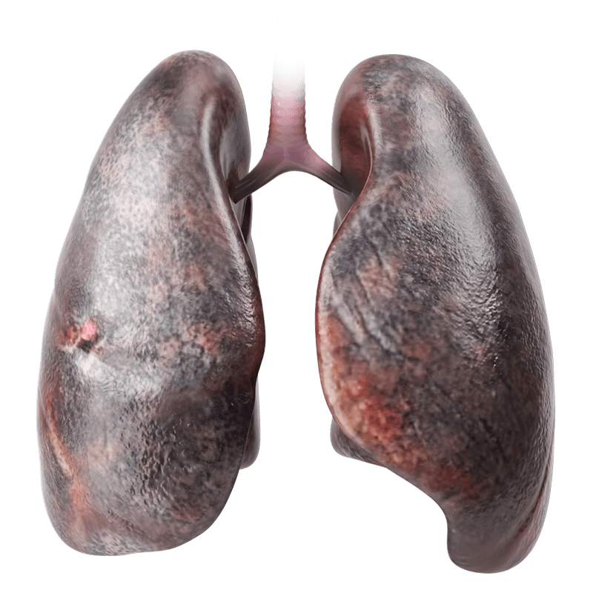
Health Danger:
Lung Injury
Vaping can cause short- or long-term breathing problems, like asthma.
Vaping increases your risk for chronic lung diseases, like emphysema, and even causes chemical burns. Vaping can also lead to lung cancer.
In 2019, a 17-year-old boy from Michigan received the first-ever double lung transplant due to vaping-related damage.
Behindthehaze.com
Notes:
SUGGESTED COMMENTS:
-Vaping causes lung injury and respiratory problems.
-Symptoms can be mild and temporary, like coughing, or more serious, like wheezing,
and even life-threatening, leading to diseases like emphysema and pneumonia.

Slide 15
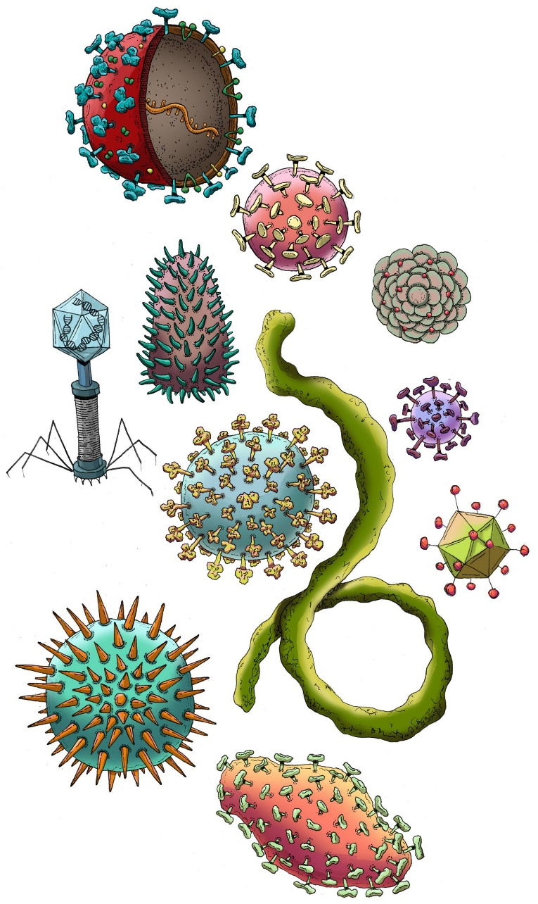
Viruses and Vaping
Vaping reduces lung function. Teens who vape are more likely to become sick.
People who share vape devices are more likely to spread viruses to each other.
National Institute on Drug Abuse
Notes:
SUGGESTED COMMENTS:
-Research during the Covid-19 epidemic showed a connection between vaping and the likelihood of becoming sick with Covid-19.
-Not only does vaping harm the immune system, but sharing vapes socially means sharing more germs.

Slide 16
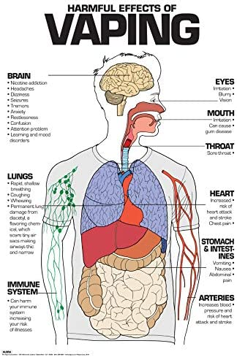
More Health Risks
What we KNOW so far…
Dry mouth, coughing, nausea and headaches
(Drugwatch.com)
Increased risk of heart disease
(Drugwatch.com)
Weakened immune system
(University of North Carolina)
Damage to gums and mouth
(University of Rochester – Sundar, et al.)
Nicotine poisoning by swallowing, breathing, or absorbing e-liquid into the skin
(American Association of Poison Control Centers)
Second and third-hand aerosol
(American Lung Association, American Academy of Pediatrics)
Seizure risk
(FDA)
Notes:
SUGGESTED COMMENTS:
-Research has shown vaping damages cells in the gums and mouth, leading to inflammation and gum disease.
-Eating or drinking small amounts of vape liquid can be fatal or cause serious illness, especially to small children and pets.
Poison control centers receive thousands of calls each year for nicotine poisonings.
-Like cigarette smoke, second and third-hand aerosol contains harmful chemicals.
Third-hand smoke and aerosol are the chemicals left on surfaces like clothes, skin and walls after they come into contact with second-hand smoke or aerosol.
-The FDA has become aware that vape use increases the risk of seizures, especially among young people.

Slide 17
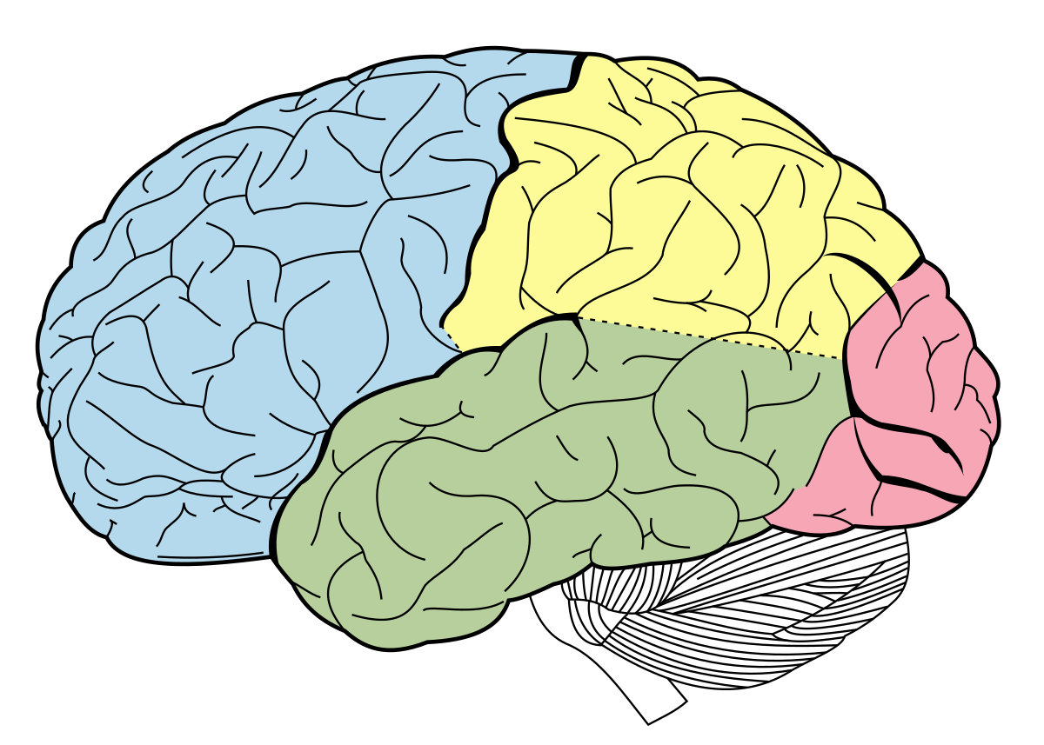
The
Human Brain
Question:
How long do you think it takes before your brain is fully developed?
National Institute on Drug Abuse
Notes:
SUGGESTED COMMENTS:
-One of the parts of the body most impacted by vaping is the brain.
DISCUSSION QUESTION:
-How long do you think it takes before your brain is fully developed?

Slide 18
The
Human Brain
Answer:
Your brain continues to develop until you are 25 or older.
Still Developing
National Institute on Drug Abuse
Notes:
SUGGESTED COMMENTS:
ANSWER:
-Research tells us that your brain continues to develop until you are 25 or older.
-People under 25 have an increased risk of become addicted to nicotine and other substances, although people of any age can become addicted.
This is because the prefrontal cortex – a part of the brain that is not fully formed in teens – plays an important role in the process of addiction.
-Being addicted to nicotine can make it easier for the brain to become addicted to other drugs.

Slide 19

Nicotine
Damages the
Developing
Brain
Nicotine harms the part of the brain that is responsible for impulse control and decision making.
Vaping can cause teens to take unhealthy risks. This includes an increased risk of smoking cigarettes, using marijuana, or trying other drugs.
Nicotine also decreases the ability to focus, learn, and remember information by changing the way the brain works.
CDC.gov

Slide 20
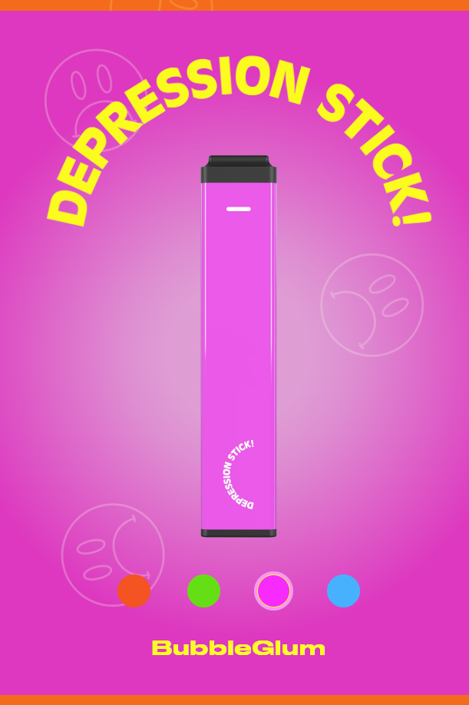
Vaping and Mental
Health
When a person is addicted to nicotine and stops using it, their body and brain have to get used to not having nicotine. This can result in temporary symptoms of nicotine withdrawal.
Withdrawal symptoms can include irritability, restlessness, problems concentrating, and trouble sleeping.
Nicotine in vapes can worsen anxiety symptoms and increase feelings of depression. Teens who start vaping to relieve stress often find themselves addicted to vaping.
Vapers experience increased suicidal thoughts, as compared to non-vapers.
CDC.gov

Slide 21

Vaping and Mental
Health
In a 2023 American Heart Association study of 2,500 people ages 13-24:
  About 6 out of 10 people who vaped THC and/or nicotine reported anxiety—versus only 4 out of 10 non-vapers.
  About 5 out of 10, or half, of vapers reported depression—versus only about 2 out of 10 of non-vapers.

Slide 22

Video: Nicotine Makes You Feel “Off”
Notes:
PLEASE NOTE THAT VIDEO MAY ONLY PLAY WHEN PRESENTATION IS IN “SLIDE SHOW” MODE. PLEASE ALLOW SEVERAL SECONDS FOR VIDEO TO LOAD.
Video Link: https://www.youtube.com/watch?v=8wv3n1bmGug
SUGGESTED COMMENT:
-Now we’ll see a short video about how vaping nicotine can negatively affect our mental health.

Slide 23

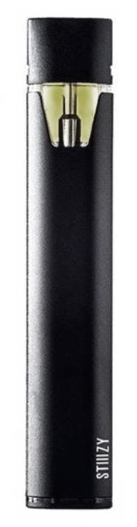
Vaping and Marijuana
THC is the chemical in marijuana that causes addiction.
Marijuana today is up to 7.5 times stronger than it was a few decades ago.
Marijuana concentrates (oils, waxes, etc.) used in vaporizers have much higher THC content than dry, smoked marijuana.
More teens enter drug treatment for marijuana than any other drug.
CDC.gov
Notes:
SUGGESTED COMMENTS:
-Marijuana is getting stronger. Marijuana plants have been bred to contain more THC, the chemical that causes addiction in marijuana.
-Certain vape devices are also used to smoke marijuana.
-Many people mistakenly think that THC in marijuana is not addictive. However, approximately 1 out of 6 marijuana users become addicted.

Slide 24
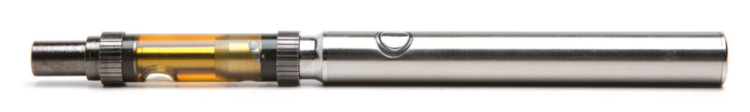
The high levels of THC in marijuana can lead to anxiety, depression and/or psychosis and can increase the possibility of addiction.
Teens using marijuana concentrates in vapes have reported panic attacks, paranoia, and hallucinations.
Marijuana may decrease the effectiveness of medication for depression.
Vaping and Marijuana
CDC.Gov American Journal of Drug & Alcohol Abuse
Notes:
SUGGESTED COMMENTS:
-High THC levels results in increased side effects and much greater possibility of addiction.

Slide 25

Vape Waste Damages the Environment
The damage to the environment from vape products that are thrown away is enormous.
  Hundreds of thousands of pounds of vape trash have already been created.
  Vapes that are discarded will not break down naturally.
  Vape waste introduces toxins into waterways, soil and wildlife—such as:
  Plastic
  Nicotine salts
  Heavy metals
  Lead
  Mercury
  Flammable lithium-ion batteries
TruthInitiative.org
Notes:
SUGGESTED COMMENTS:
-Used vape devices are presenting an environmental hazard.
-Vapes are often littered directly onto the ground or into bodies of water.
-Even vapes that are thrown in the trash or recycling are very damaging to the environment.

Slide 26

Vape Waste Damages the Environment
Vape manufacturers are not taking responsibility for the vape waste.
Almost half of vape products do not have disposal instructions.
Manufacturers do not provide services for safe vape waste disposal.
TruthInitiative.org
Notes:
SUGGESTED COMMENTS:
-Vape manufacturers want to sell their products and make money but are doing nothing to reduce the environmental impact of vape waste.
-Disposable vapes are one-time-use products that are now very popular, further adding to the problem.

Slide 27
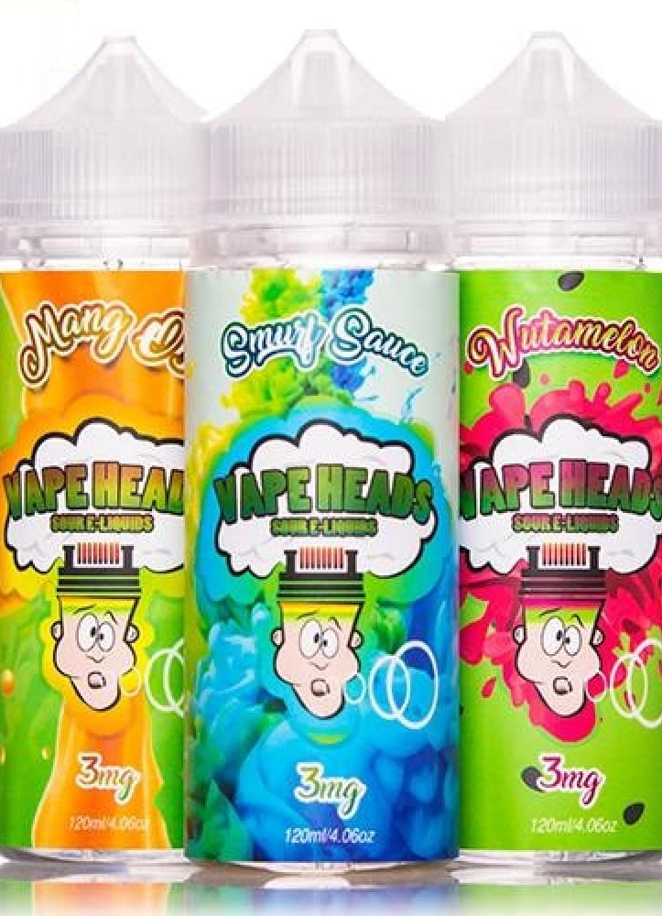

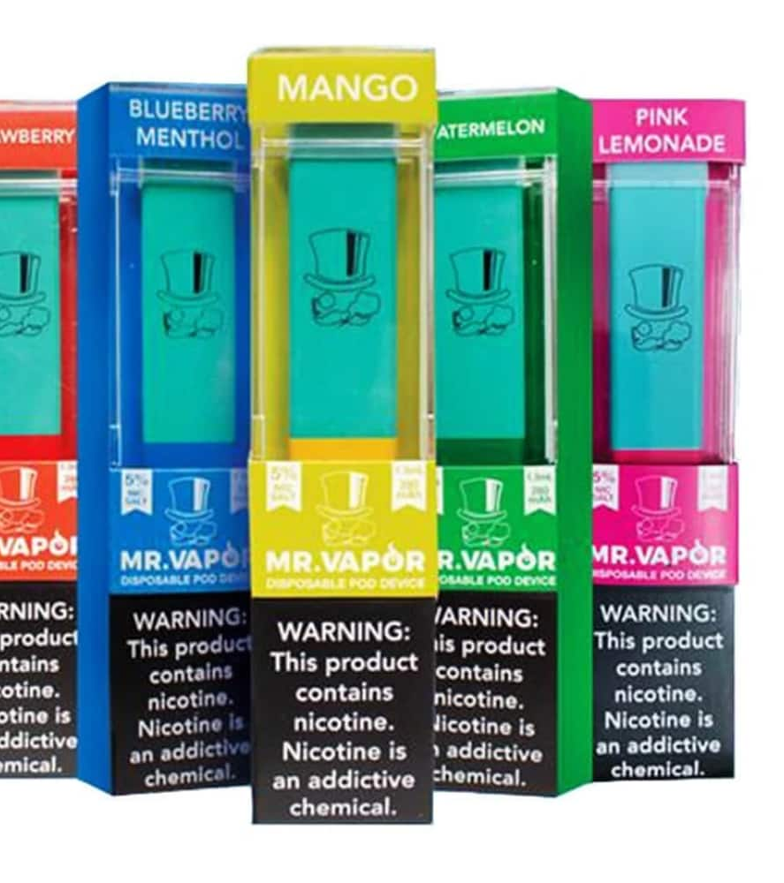
Vape Companies Use Flavors to Target Youth
Notes:
SUGGESTED COMMENTS:
-Vape manufacturers are using flavors that appeal to children and teens. The bright, colorful labels of some vape products are designed to look like candy packaging.
-Public health officials are concerned that vape manufacturers are purposely targeting younger customers in order to keep their business for a very long time.
(Campaign for Tobacco Free Kids)

Slide 28
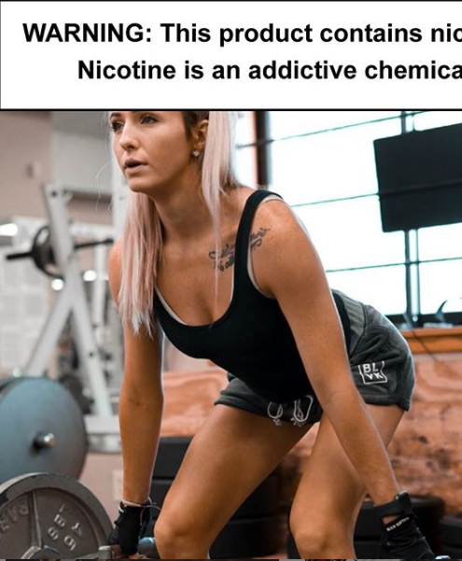

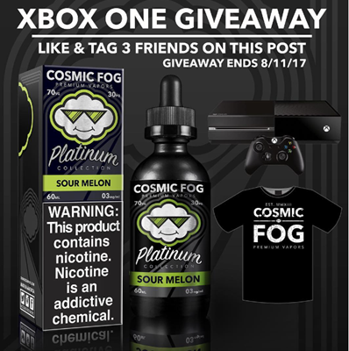
Vape Companies Target You…
TruthInitiative.org
Notes:
SUGGESTED COMMENT:
-Just like cigarette companies, vape companies use models to promote their products.
-By using models in their advertising, vape companies try to make their products seem more popular, attractive or sophisticated.
-Sports and fitness images are used to make vaping seem like part of a healthy lifestyle.
-Some vape companies promote their products on social media and offer contests that appeal to young people.
-This is a time in your life when, very appropriately, you want to be independent. However, addiction will prevent you from making independent decisions.
DISCUSSION QUESTION:
-Now that you know all this, why do you think companies make these products?

Slide 29

Notes:
PLEASE NOTE THAT VIDEO MAY ONLY PLAY WHEN PRESENTATION IS IN “SLIDE SHOW” MODE. PLEASE ALLOW SEVERAL SECONDS FOR VIDEO TO LOAD.
Video Link: https://youtu.be/U4ZfGTKnPJY
SUGGESTED COMMENT:
-This video will review some of the things we’ve discussed.

Slide 30

How Can I Get Help to Quit?
Talk to Your
Student Assistance Specialist,
School Counselor,
or School Social Worker
Go to:
MyLifeMyQuit.com
Or:
Text “Start” to 855.891.9989
Notes:
SUGGESTED COMMENTS:
-If you are worried that you or a friend is addicted to nicotine or any other substance, talk to your Student Assistance Specialist, counselor or social worker.
He/she can help connect you with appropriate resources.
-My Life, My Quit is available for free to teens age 13-17. Teens receive five phone or text sessions with a trained counselor.
-The Michigan Quitline (1-800-QUIT-NOW) offers four free sessions with a trained tobacco cessation counselor over the phone.
Any Michigan resident 18 or older is eligible for the service.

Slide 31






Want More Information?
National Institute on Drug Abuse (NIDA)
Centers for Disease Control and Prevention (CDC)
Department of Health and Human Services (The Real Cost of Tobacco)
Food and Drug Administration (FDA)
Tobacco Free Kids
Truth Initiative
Behind the Haze.com
Notes:
If you click on the citations on this slide, you will be able access the websites for more information.
SUGGESTED COMMENT:
-There is a lot of information available about vaping. Some is accurate, some is not.
-If you would like to learn more about vaping, it is worth doing some research.
-The organizations listed are actively involved in research about vaping and their potential impact on health and wellness.

